Slide 1

Speech Recognition Using HMM
Presentation By :
Sai Leela Uruvakili
Jahnavi Garikapati
Kowsalya Mayaluri
Giri Chandragiri
Shagun Suresh

Slide 2

Table Of Contents:
Objective
Introduction to Speech Recognition
Hidden Markov Model(HMM)
An Example
Forward Algorithm
High-level Architecture
Feature Extraction
Acoustic Model
Language Model
Conclusion
References

Slide 3
Objective
This presentation aims to introduce speech recognition, focusing on the application of Hidden Markov Models (HMM). It covers HMM basics, includes a practical example, explains the Forward Algorithm, explores the Acoustic and Language Models, and concludes by summarizing the key concepts. Ended with basic implementation of the model also provided with some references .The goal is to equip the audience with a clear understanding of HMM's role in speech recognition.

Slide 4

Introduction to speech recognition
Speech signal primarily conveys the words or message being spoken. Area of speech recognition is concerned with determining the underlying meaning in the utterance. Success in speech recognition depends on extracting and modelling the speech dependent characteristics which can effectively distinguish one word from another.

Slide 5
What is HMM?
Hidden Markov Models (HMMs) are statistical models used for modeling sequential data, where the underlying system is assumed to be a Markov process with unobservable (hidden) states. The model consists of two main components:
Hidden States: These are the unobservable states of the system, which are assumed to form a Markov chain. Each state generates an observation based on a probability distribution.
Observations: These are the visible outputs or measurements associated with each state. Each state has a probability distribution over possible observations.

Slide 6
A Simple Example
States:
- Sunny (S)
- Rainy (R)
Observations:
- Walk (W)
- Shop (S)
- Clean (C)

Slide 7

Assume the following transition probabilities between states:
- P(Sunny today | Sunny yesterday) = 0.7
- P(Rainy today | Sunny yesterday) = 0.3
- P(Sunny today | Rainy yesterday) = 0.4
- P(Rainy today | Rainy yesterday) = 0.6
And the emission probabilities for observations:
- P(Walk | Sunny) = 0.6, P(Shop | Sunny) = 0.3, P(Clean | Sunny) = 0.1
- P(Walk | Rainy) = 0.2, P(Shop | Rainy) = 0.4, P(Clean | Rainy) = 0.4
Starting with a known initial state (e.g., Sunny), you can use the HMM to model the sequence of observations and infer the most likely sequence of hidden states over time.
For example, if the sequence of observations is "Walk, Shop, Clean," you can use the HMM to estimate the most likely sequence of hidden states (Sunny or Rainy) that would explain this sequence of observable events. This involves employing the Viterbi algorithm or other methods to find the optimal path through the hidden states given the observed sequence.

Slide 8
Understanding of Hidden Markov Model
HMM is very rich in mathematical structure and hence can form the theoretical basis for use in a wide range of application.
HMM model, when applied properly works well in practice for several important application.

Slide 9
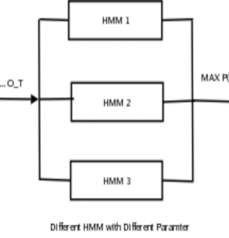
The Basic Problem of HMM
Evaluation problem:
Given the observation sequence O = O1 O2 · · · OT , and model λ = (A, B, π), how do we efficiently compute P(O|λ), the probability of observation sequence given the model. problem 1 is evaluation problem i.e given observation sequence and model.
How do we compute probability that observed sequence was produce by the model. we can think it as scoring problem. if you have to choose between many competing model then one with maximum probability will give better result.

Slide 10


Forward Algorithm for Evaluation Problem [P(O|λ)]
we want to find P(O|λ), given the observation sequence O = O1, O2, O3, · · · , OT . The most straightforward way to find the solution is enumerating every possible state sequence of length T. Consider one such state sequence Q = q1, q2, q3, · · · , qT such that q1 produces O1 with some probability, q2 produces O2 with some probability and so on. so using chain rule.
But the order of chain rule is , since at every t = 1, 2, · · · , T, there are N possible states which can be reached. This is clearly and inefficient algorithm, to overcome this forward algorithm is used.

Slide 11
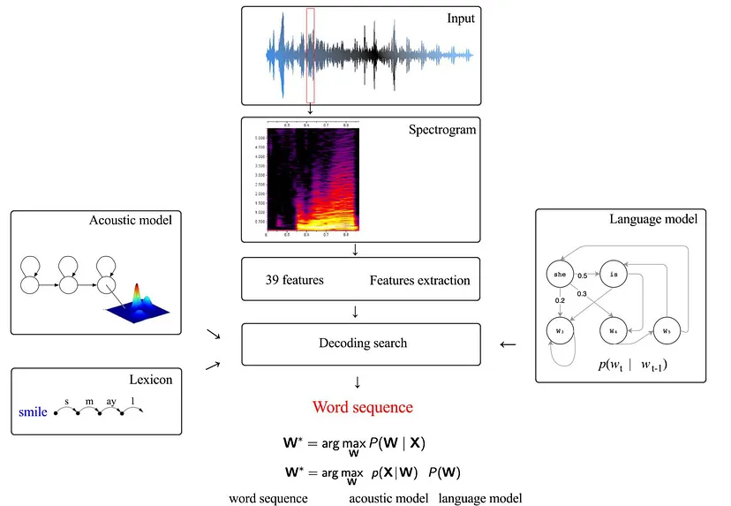
High-level architecture for speech recognition

Slide 12
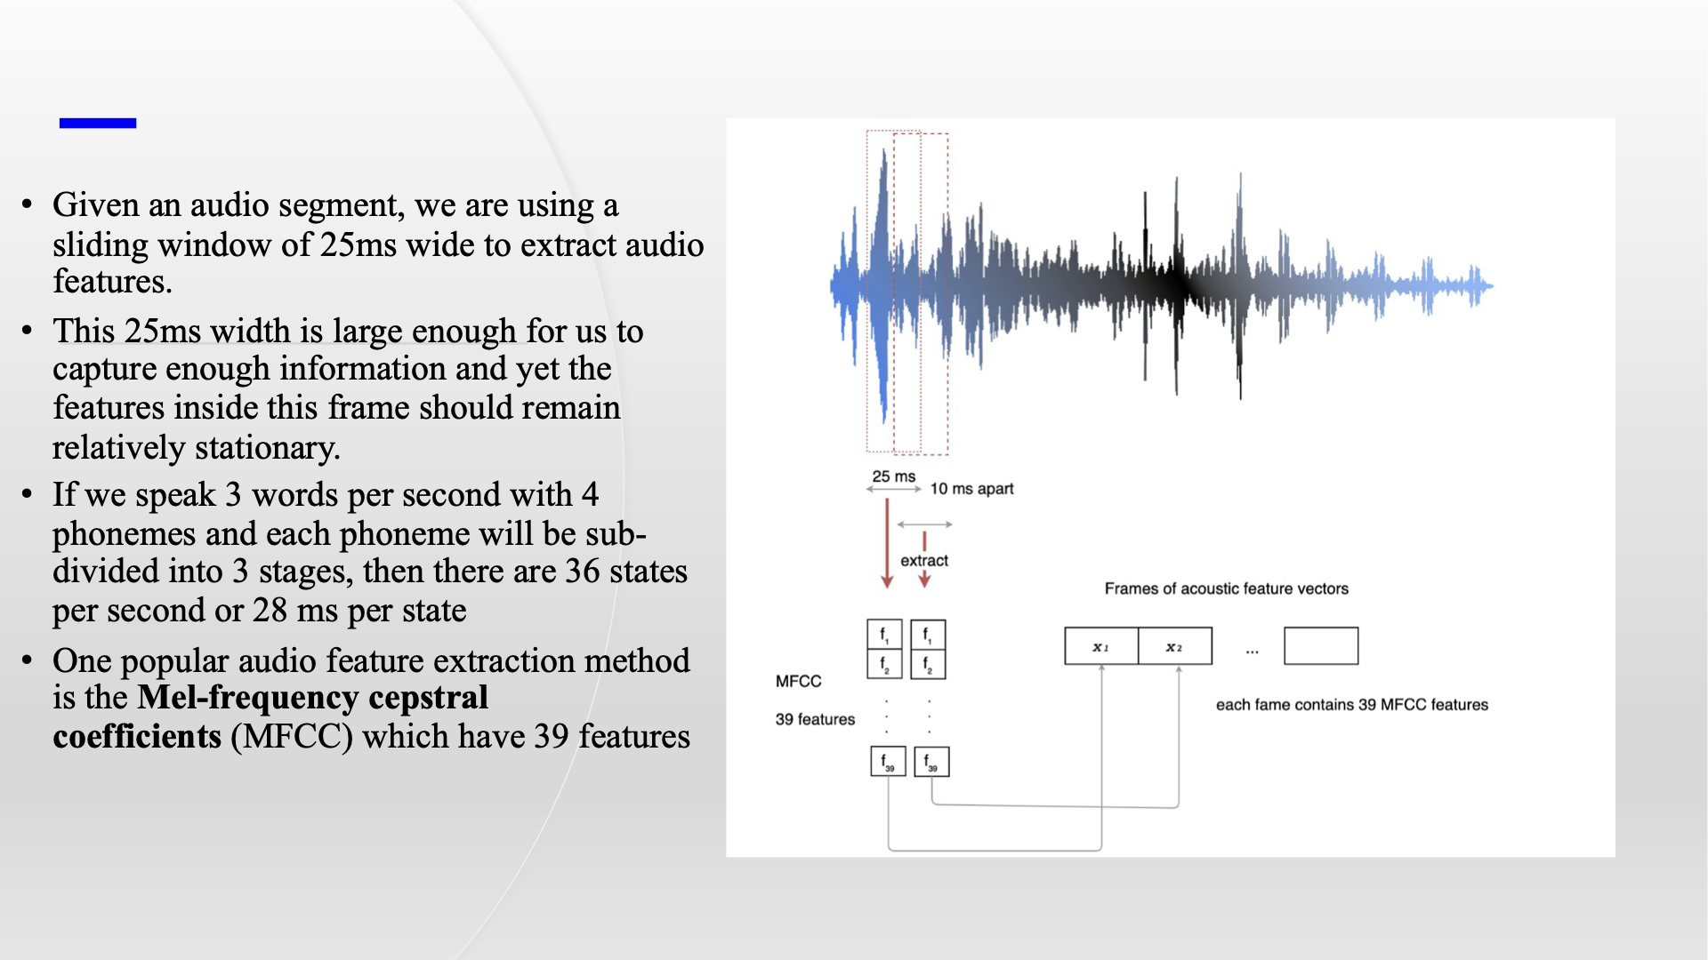

Slide 13
Feature Extraction:
The purpose of feature extraction module is to convert speech waveform to some type of representation for further analysis and processing, this extracted information is known as Feature Vector.
The process of converting voice signal to feature vector is done by signal-processing front end module. As shown in above block diagram input to front-end is noise free voice sample and output of it is feature vector.
In feature matching, the extracted feature vector from unknown voice sample is scored against acoustic model, the model with max score wins ,and it’s output is considered as recognized word.

Slide 14
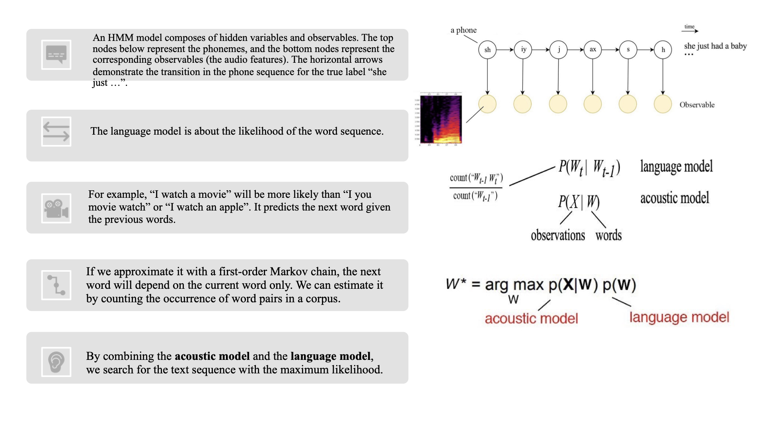

Slide 15
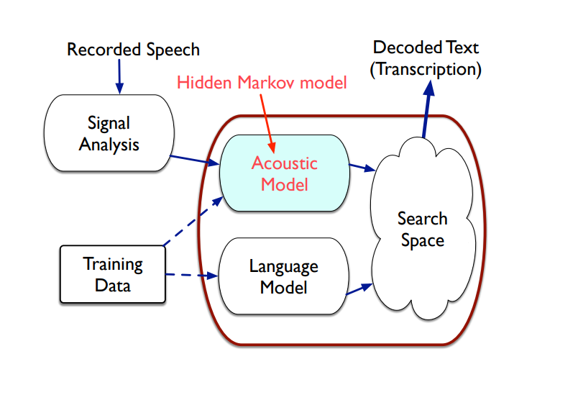
Acoustic Model:
In speech recognition, basic unit of sound is phoneme(Phones). Phoneme is a minimal unit that serves to distinguish between meanings of words.
For example, Sequence of phoneme for “Need” is n, iy and d. In English language there are nearly around 44 phoneme(Sounds).
In order to recognize a given word, we should extract phoneme from voice sample.

Slide 16
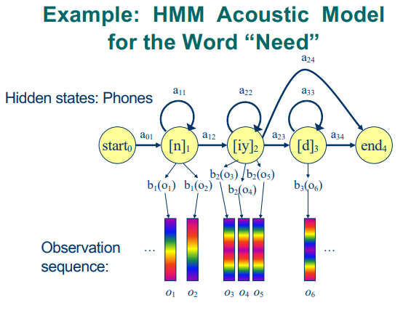
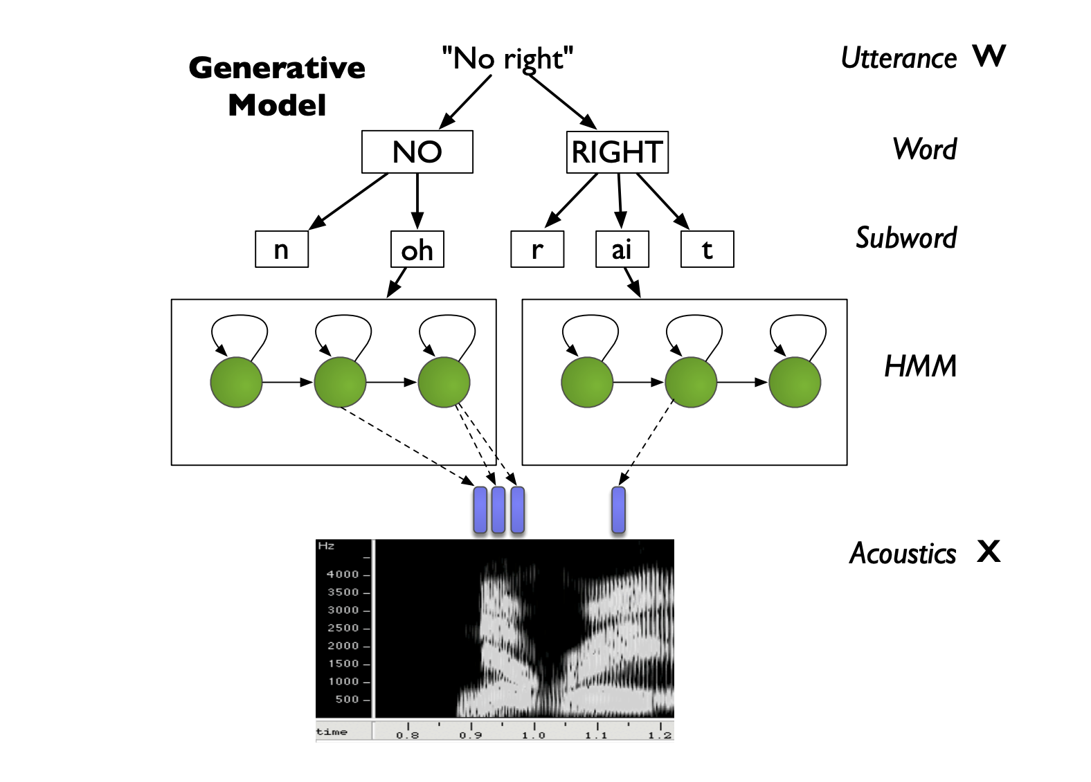
Acoustic with HMM examples:

Slide 17
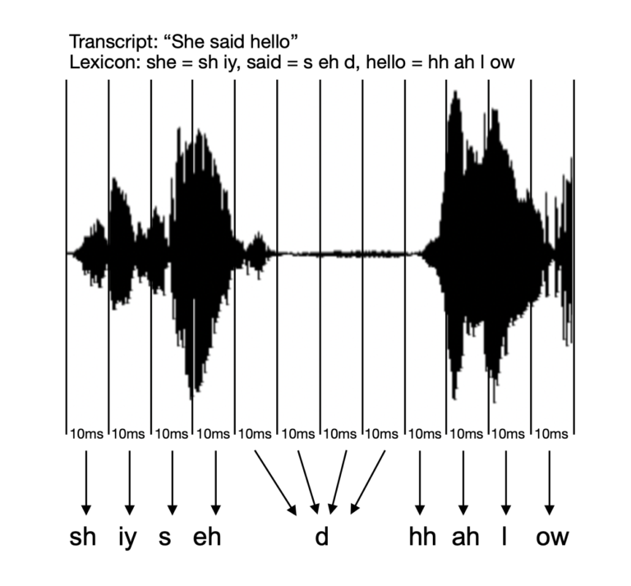
Lexicon:
It helps distinguish linguistics like accents and similar sounding words ...
The entire acoustic model is defined by taking the lexicon pronunciation HMM
For example, Speaker says “She said hello”
Lexicons - sh iy s eh d hh ah l ow
- sh e s ei d ha l ow

Slide 18
Language Model:
The model that compute P(W) is known as Language model.
Given a sentence how one can calculate the joint probability. One way is to use chain rule.
In general P(A, B, C, D) = P(A).P(B|A).P(C|A, B).P(D|A, B, C).
Language model help us in generating search graph. Search graph is collection of HMM of each phoneme in given vocabulary.

Slide 19
Decoding Search:
During decoding, the system tries to find the most likely sequence of words or phonetic units that match the observed features from the audio. The Viterbi algorithm is commonly used for this purpose.​
Initialization: The decoding process begins by initializing probabilities for the starting states of different phonetic units.
Forward Algorithm: The algorithm calculates the probability of being in each state of the HMM at each time step, considering the observed features and transitioning between states.
Backtracking: As the algorithm progresses through the HMM, it keeps track of the most likely path by considering both the current state's probability and the transition probabilities from the previous state.
Termination: Once the entire audio signal has been processed, the algorithm identifies the most likely sequence of phonetic units by backtracking through the best path determined by the Viterbi algorithm.

Slide 20
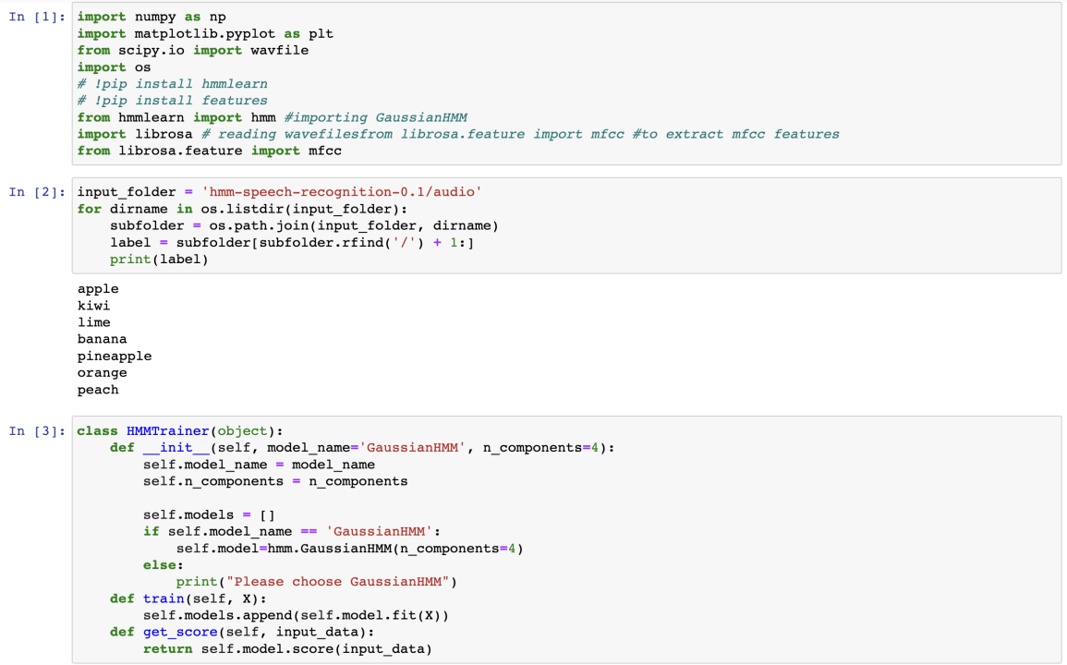
Implementation:

Slide 21
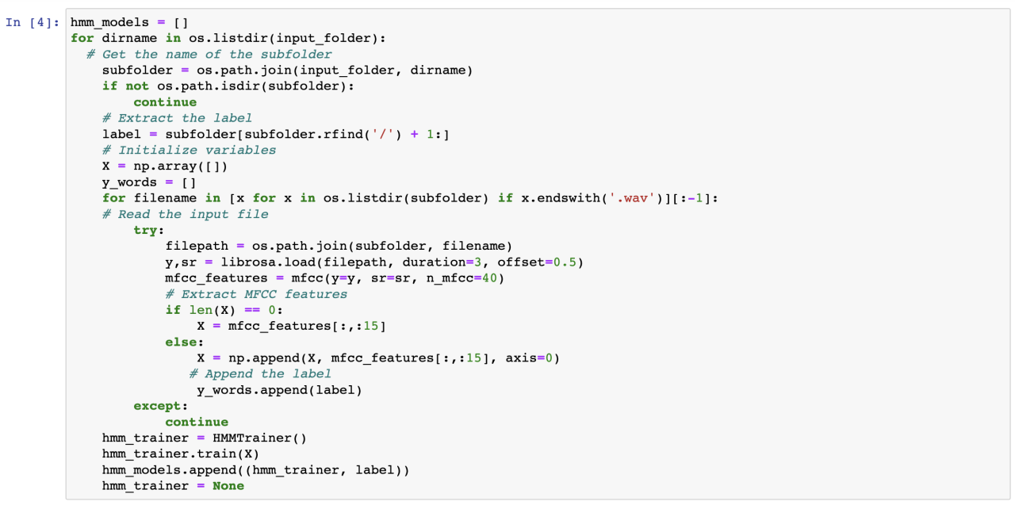

Slide 22
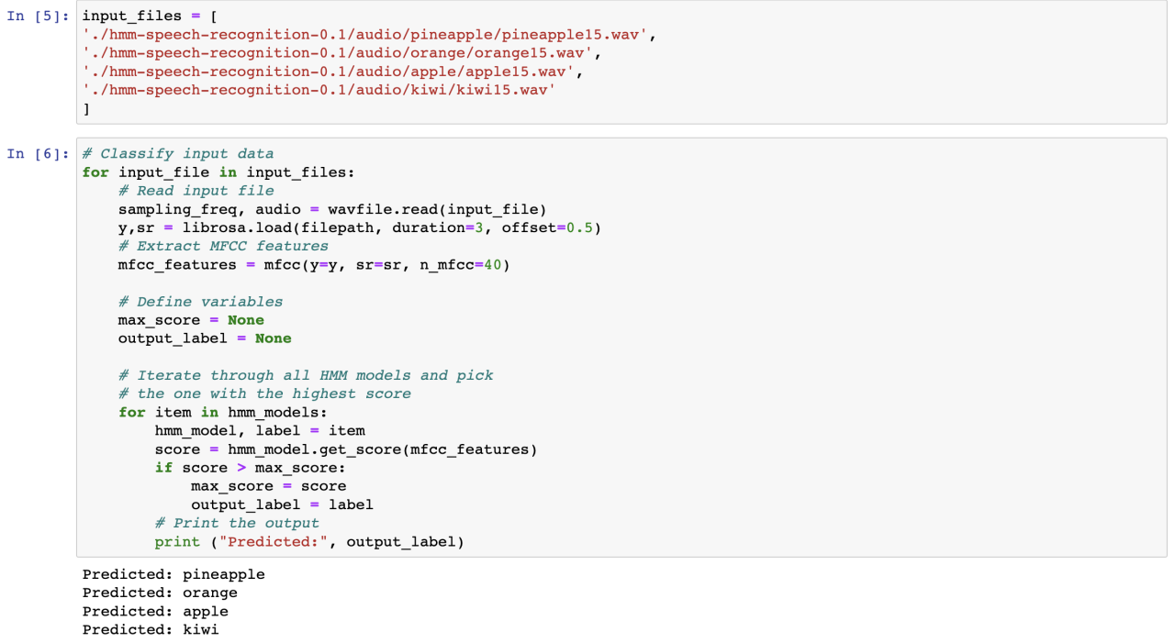

Slide 23

Conclusion:
We saw how HMM can be used as signal model for speech recognition application. Also represented Mathematical understanding of Hidden Markov Model.
Speech recognition using HMM gives good result due to resemblance between architecture of HMM and varying speech data.
HMM-based speech recognition can be extensively used in various applications, including virtual assistants, dictation systems, voice-controlled interfaces, and customer service automation.

Slide 24
References:
https://en.wikipedia.org/wiki/Hidden_Markov_model
https://www.youtube.com/watch?v=mNSQ-prhgswPattern Recognition and Machine Learning
L. R. Rabiner, “A tutorial on hidden Markov models and selected applications in speech recognition,” Proceedings of IEEE, vol. 77, no. 2, pp. 257–286, 1989.
Lawrence R. Rabiner. A Tutorial on Hidden Markov Model and Selected Applicaiton in Speech Recognition. IEEE, 1989.

Slide 25
Thank You All

